Slide 1


Sales Strategy Analysis – New Product Launch
A data-driven examination of three distinct sales methods for our new stationery line, analyzing performance metrics to optimize future campaign strategies.
by Abdulafeez Fakorede

Slide 2

Business Goals
1
Evaluate 3 sales methods for new stationery line
Email campaigns
Phone calls
Combined email + call approach
2
Determine key performance indicators
Which method generated the highest revenue?
Which method demonstrates the greatest efficiency?
3
Develop recommendation
Provide a data-driven strategy recommendation for future sales campaigns based on comprehensive analysis

Slide 3

Data Overview
15,000
6
Customers
Weeks
Total sample size analyzed
Time period since product launch
3
Distinct Sales Methods tested
Email, Call, Email + Call
Data includes, Week since product launched (1-6), sales method, customer_id, revenue, products sold, Years as Customers, website visit frequency and shipment state

Slide 4








🔧 Data Cleaning and Validation
I reviewed and cleaned the dataset containing 15,000 customer records across 8 columns. Below is a detailed breakdown of the validation and cleaning steps performed for each column:
Column-by-Column Validation
week
sales_method
Confirmed all values are integers between 1 and 6 (since product launch).
Initially contained 5 inconsistent values (e.g., "Em + Call", "email").
No missing values detected.
Standardized formatting using title case.
Corrected "Em + Call" to "Email + Call", resulting in 3 valid categories.
customer_id
nb_sold
All 15,000 entries were unique — no duplicates or missing values found.
Confirmed values ranged between 7 and 16, and datatype is integer.
No missing or suspicious values.
revenue
years_as_customer
Identified 1,074 missing values (~7.2%).
Values ranged from 0 to 63 — valid based on company history.
Imputed missing values using the mean revenue per sales_method.
No missing or invalid values; outliers retained after review.
Verified all values are floats, and no missing entries remain after imputation.
Retained high-value outliers as they are plausible in B2B sales.
nb_site_visits
state
Values ranged from 12 to 41 — appropriate for a 6-month window.
50 unique U.S. state values confirmed — no typos or null entries.
No missing values; distribution appears consistent.
Column is consistent and clean.
Outliers
Inspected using descriptive statistics and boxplots for: revenue, nb_sold, years_as_customer, and nb_site_visits.
Outliers were kept, as they represent valid edge-case customer behavior (e.g., high purchases, legacy clients).

Slide 5
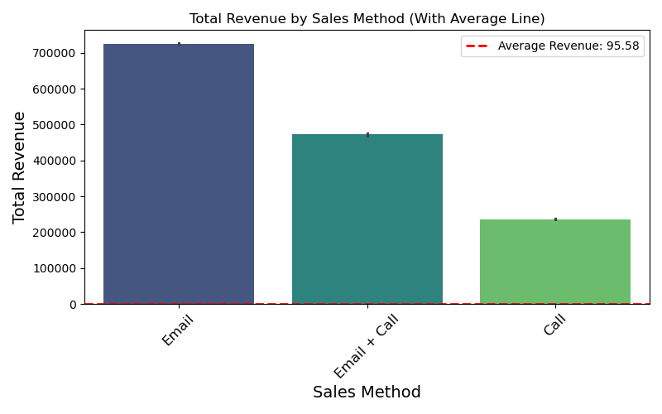
Total Revenue by Sales Method
Key Insight: Email brought in the highest total revenue, with Email + Call following closely behind, and then Call.
Key Insight: Email brought in the highest total revenue, with Email + Call following closely behind, and then Call.

Slide 6
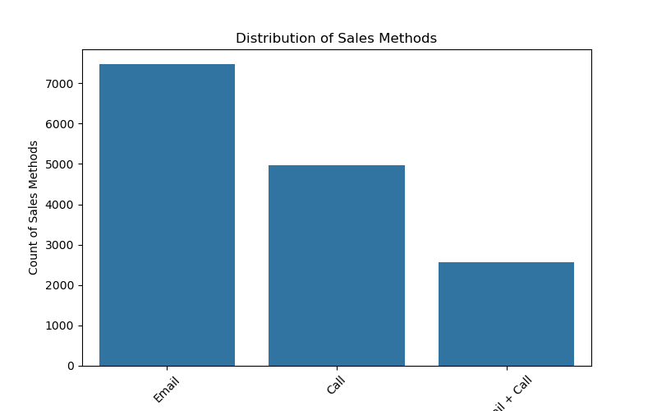
Total number of Sales per Method
Key Insight: Email dominates in the number of orders, with Call coming next, and Email + Call in the third position. Notably, Email + Call outperformed Call in revenue, underlining the high value orders in Email + Call
Key Insight: Email dominates in the number of orders, with Call coming next, and Email + Call in the third position. Notably, Email + Call outperformed Call in revenue, underlining the high value orders in Email + Call

Slide 7
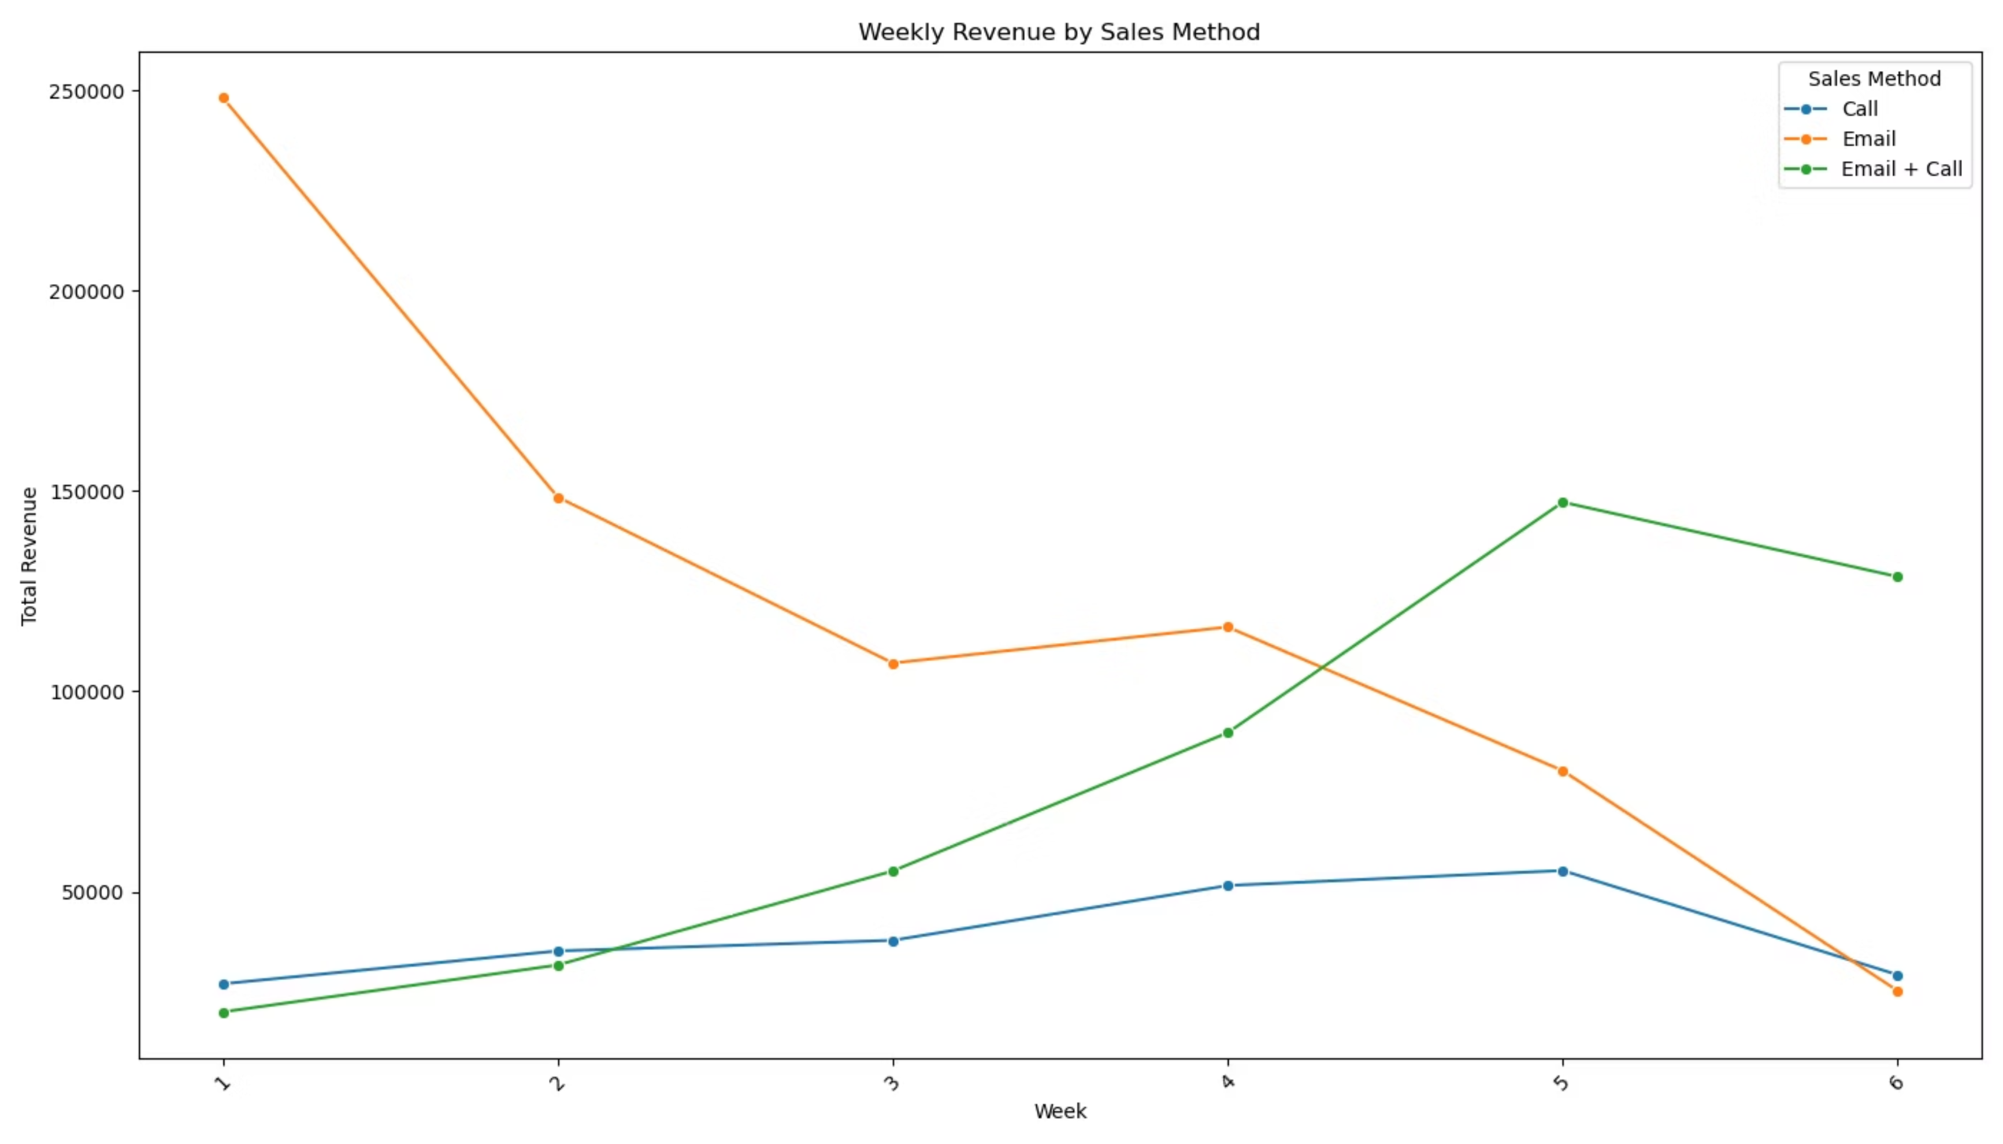
Revenue Over Time
Email shows strong initial performance but gradually declines, while Email + Call demonstrates consistent growth, overtaking Email by week 4. Call-only remains the least effective throughout the entire period.

Slide 8



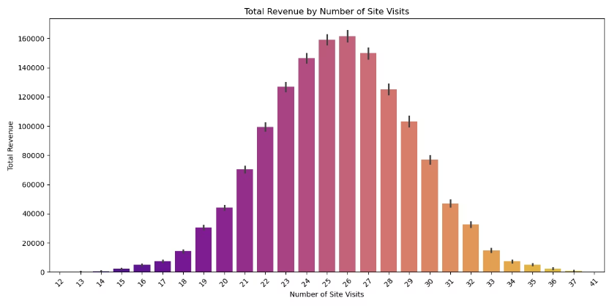
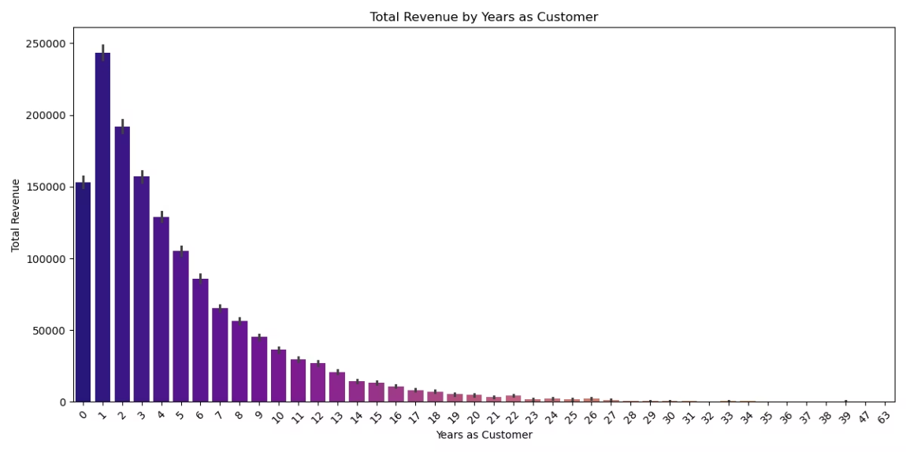
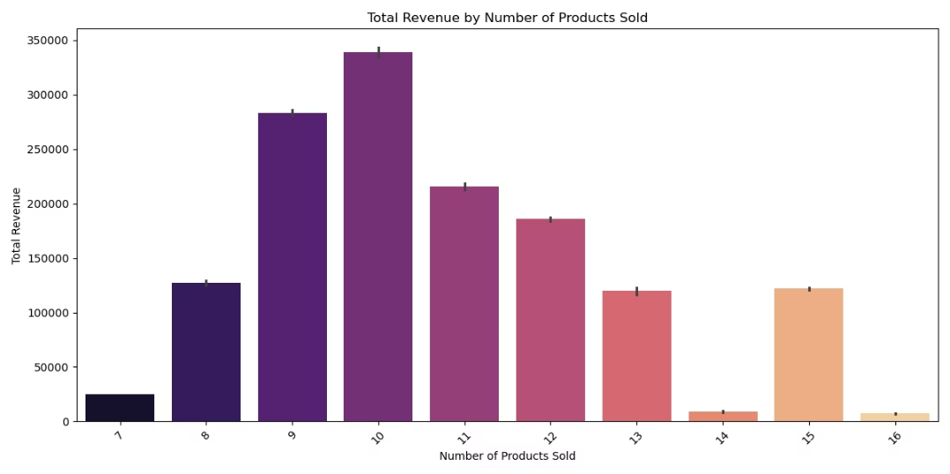
Customer Behavior Insights
Site Visit Impact
Revenue increases steadily with site visits up to 26 interactions, then shows diminishing returns with highly frequent visitors
Customer Tenure
Newer customers (0-3 years) generate significantly more revenue than long-term customers when targeted with these sales methods
Purchase Volume
The most profitable sales transactions involve approximately 10 items per order, suggesting an optimal bundle size

Slide 9


Key Metric to Monitor: ARPC
Average Revenue per Customer per Sales Method
This comprehensive metric captures both the effectiveness and efficiency of each sales approach, providing a clear indicator of overall performance.
Weekly Tracking
Monitor this metric on a weekly basis to identify trends and shifts in customer response
Dynamic Adjustment
Use performance data to guide real-time campaign optimization
Sales Method | ARPC by Sales Method
Call | $47.60
Email | $97.10
Email + Call | $183.70

Slide 10

Strategic Recommendations
1
Track ARPC Weekly
For each sales method to guide decision
Prioritize Email + Call approach
3
Maintain Email campaigns for baseline reach
2
This combined method delivers the best performance with moderate resource investment, generating 89% more revenue per customer than email-only
Use email-only for low-effort base campaigns when resources are limited, as it provides reasonable returns
4
Eliminate Call-only strategy
5
Target engagement sweet spot
This approach demonstrates low return despite high resource requirements, making it inefficient for future campaigns
Focus particularly on new (0-3 years), highly engaged customers with 22-28 site visits for maximum revenue potential

Slide 11

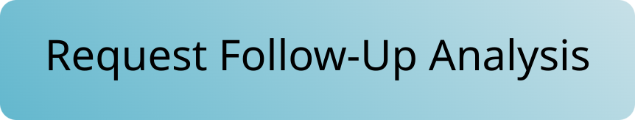

Thank You
Questions & Discussion
We welcome your insights and questions about the analysis. Your feedback will help refine our sales strategy for the new stationery line.

